Slide 1

microServiceBus.com
tutorial
Mikael Hakansson
mikael.hakansson@axians.com

Slide 2
IoT Device Management - using microServiceBus.com
Introduction
AXIANS IoT – View on Internet of Things
Labs

Slide 3





http://bit.ly/msbtutorial
Tools & Services
Chrome
Node.js
Visual Studio Code
Postman
GitHub
microServiceBus

Slide 4
Axians IoT Nordic’s
take on IoT

Slide 5






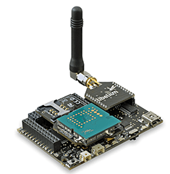














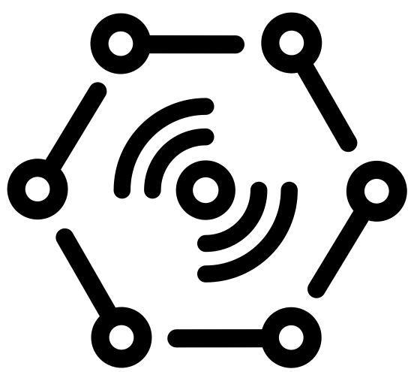





Challenges
Security
Onboarding
Hub independence
Updates & Patches
Issue tracking (ITIL)
Monitoring & Operation
Reports
“Any DEvice”
Value
Apps
DATA
“Any Data Source”
“Any IoT platform”
Monitoring
“Any PROTOCOL”
Machine
Learning
PROTOCOL
DATA
LOB
Modbus
Wi-Fi
LoRa
Serial

Slide 6

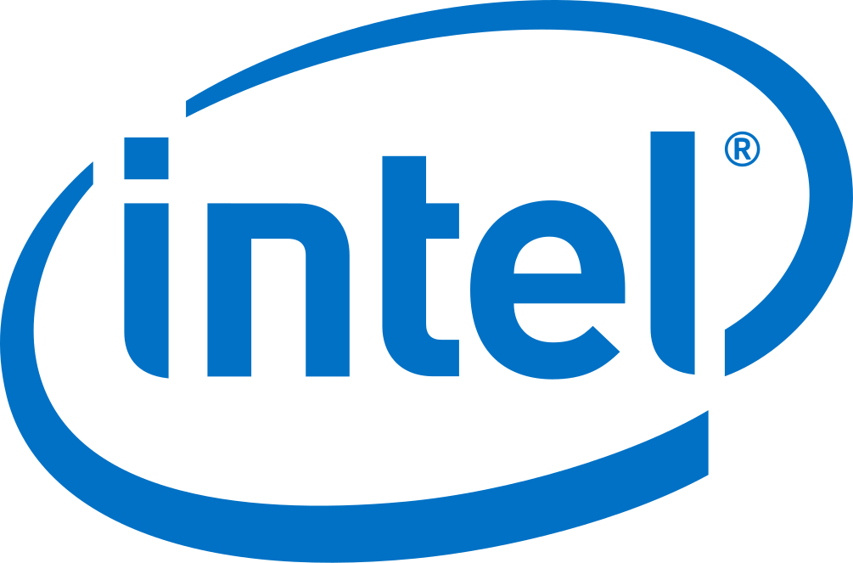




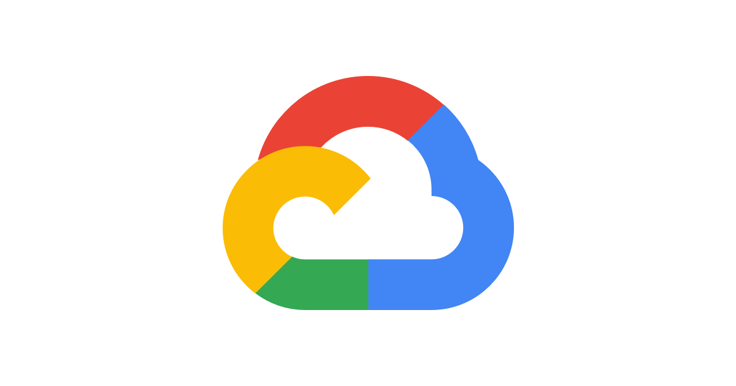
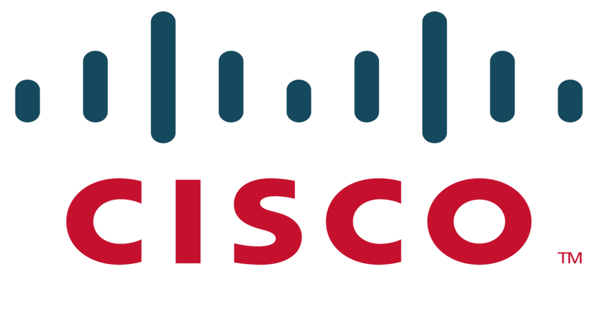




IoT Operations generic offering
IoT Operation
PLC’s
Machines, Sensors,
meters etc...
Gateway (Devices)
Communi-cation
Cloud
IoT Operations
Business Solution
Set price per device & month.

Slide 7
Customer Response

Slide 8

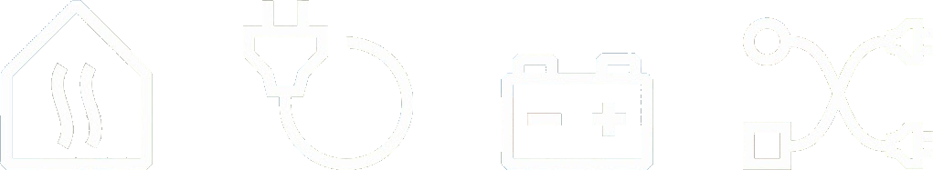

DES Business Platform
HEAT
POWER
CHARGE
SMART

Slide 9

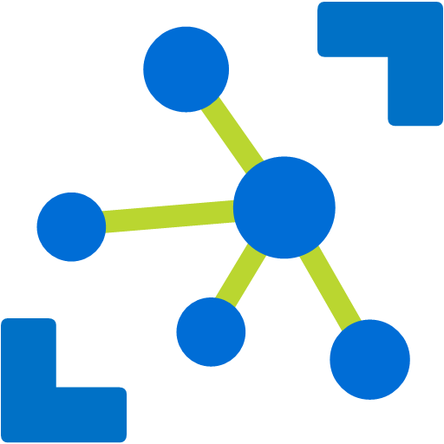





















HEAT
POWER
CHARGE
METER
Power meter
IoT Hub
des.vattenfall.com
Power meter
DES Portal
Heat pump
//
Analysis storage
- decrypt
- de-batch
- ingest
Energy meter
Energy meter
DES Event processing
Cold storage
Field Gateway
vattenfall.microServiceBus.com
Application
{modbus}
Device Management

Slide 10


HEAT
POWER
CHARGE
METER
Power meter
IoT Hub
des.vattenfall.com
Power meter
DES Portal
Heat pump
//
Analysis storage
Energy meter
Energy meter
DES Event processing
Cold storage
Solar home
Field Gateway
vattenfall.microServiceBus.com
Application
Device Management
Charge

Slide 11
HEAT
POWER
CHARGE
METER
Limit

Slide 12










HEAT
POWER
CHARGE
METER
Site
IoT Hub
des.vattenfall.com
DES Portal
Power meter
Solar
Spot Price
Battery controller
Machine learning
DES Event processing
Weather
Wind
Field Gateway
Battery
vattenfall.microServiceBus.com
AI
Device Management
Grid

Slide 13
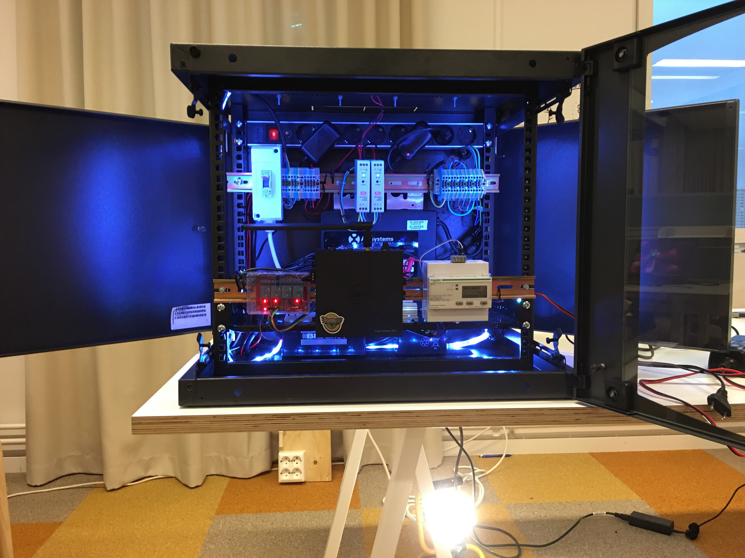
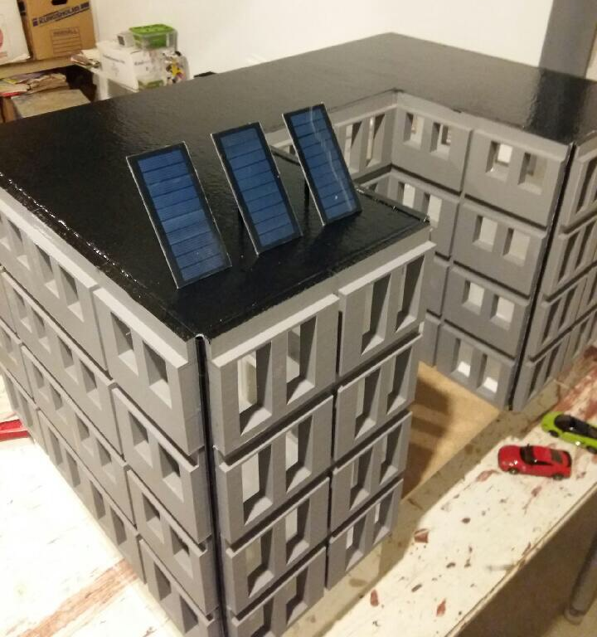

HEAT
POWER
CHARGE
SMART

Slide 14

SANDVIK INTELLIGENT TUBE
Sandviken - Intelligent Tubes
SMART INDUSTRY

Slide 15

The Edge , - Amsterdam

Slide 16

Berlin - Subway

Slide 17

Rotterdam - Harbor

Slide 18
So how does microServiceBus.com fit in?

Slide 19


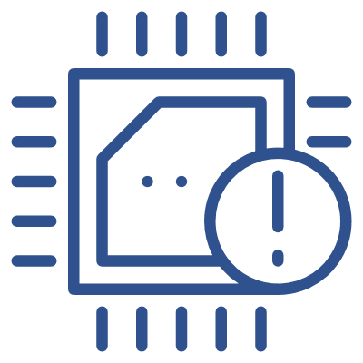



AXIANS IoT Operations
Level of commitment
IoT Operations
Issue management
Problem management
Release management
Remote updates
OTA application updates
OTA firmware update
Control application
Security (lock-down)
Configuration update
Cloud to device communication
Monitoring
Are devices online?
Are there vulnerabilities?
Is someone tempering with the device?
Am I missing data?
Is the data plan close to the limit?
What is the health of the device?
What is the health of the services?
Provisioning
Onbording new devices
Site verification
Building application
Connect to equipment
Transmit data
Persist data in the cloud

Slide 20
microServiceBus.com - Device Management
On-boarding
Updates and patching
Source code management
Find and resolve issues
On-boarding new devices is difficult at scale. Gateways needs to automatically get assigned a cloud identity, receive keys and certificates. -All in a highly secure manner.
microServiceBus.com provide a scalable, cross cloud vendor solution based either on integration with SIM card management tools like Cisco Jasper or MAC address white-listening.

Slide 21
microServiceBus.com - Device Management
On-boarding
Updates and patching
Source code management
Find and resolve issues
No part of any system will stand the test of time. Software is constantly updated to align with security threats or new required features.
Update and patching are easily handled through microServiceBus.com, either through replacing entire firmware or individual services. Updates can be done manually or through scheduled tasks, for single, all or groups of devices.
Easy deployments to IoT devices makes ways for Agile development!

Slide 22
microServiceBus.com - Device Management
On-boarding
Updates and patching
Source code management
Find and resolve issues
Source code and services are not only deployed to devices, but needs to be audited and versioned to ensure the end-to-end business process.
With complete insight and traceability, code can be fully managed and versioned within the microServiceBus.com portal. However, we also integrate with Git repositories such as GitHub and Azure DevOps.

Slide 23
microServiceBus.com - Device Management
On-boarding
Updates and patching
Source code management
Find and resolve issues
Identifying and resolving problems can be a difficult mission in any system, but spread over many thousands of remotely located units brings it to a whole other level!
microServiceBus.com provides great insight to what is and has happened on the device. Through it’s tracking capabilities, developers and operation staff can gain insight of what is happening, and even remotely debugging the code, and instantly deploy fixes.

Slide 24
microServiceBus.com - Device Management
Hardware independence
Platform independence
Cloud vendor independence
Integration
New devices and gateways are coming available on the market at a stunning rate, while old models are being discontinued. Choosing a platform that can run independently of your choice of hardware, is critical for long term success.
The microServiceBus agent is designed to run on almost any platform while still being managed in the same reliable way.

Slide 25
microServiceBus.com - Device Management
Hardware independence
Platform independence
Cloud vendor independence
Integration
Choice of platform, in most cases, are directly related to the choice of hardware. Gateway- and device vendors support different platforms best suited for their hardware, which can become a challenge should you need other type of devices or replacing existing.
microServiceBus.com supports a number of platforms spanning from small microcontroller using MBed, embedded devices using Yocto or Buildroot or container-based platforms such as Docker or Ubuntu Core.

Slide 26
microServiceBus.com - Device Management
Hardware independence
Platform independence
Cloud vendor independence
Integration
The choice of cloud provider is of much greater importance than selecting IoT Hub. In the best of worlds, IoT Hubs are nothing but a very scalable ingestion system for where the data actually matters.
microServiceBus.com is NOT an IoT Hub, but extends and integrate with market leaders such as Microsoft, Amazon and IBM. Through microServiceBus.com you can even switch your devices from one IoT Hub to another, which can come critical in case of cloud data outage.

Slide 27
microServiceBus.com - Device Management
Hardware independence
Platform independence
Cloud vendor independence
Integration
microServiceBus.com extends to a complete Application Lifecycle Management system through its integration with 3rd party vendors, and continues to expand through its extensive API.
As of today, microServiceBus.com integrate with ServiceNow for Issue, problem- and release management, allowing customers to align their existing service desk and Nightly Operation Center (NOC). Integration with Cisco Jasper makes way for a compete SIM card management, along with GitHub, Azure DevOps, Active Directory and more.

Slide 28
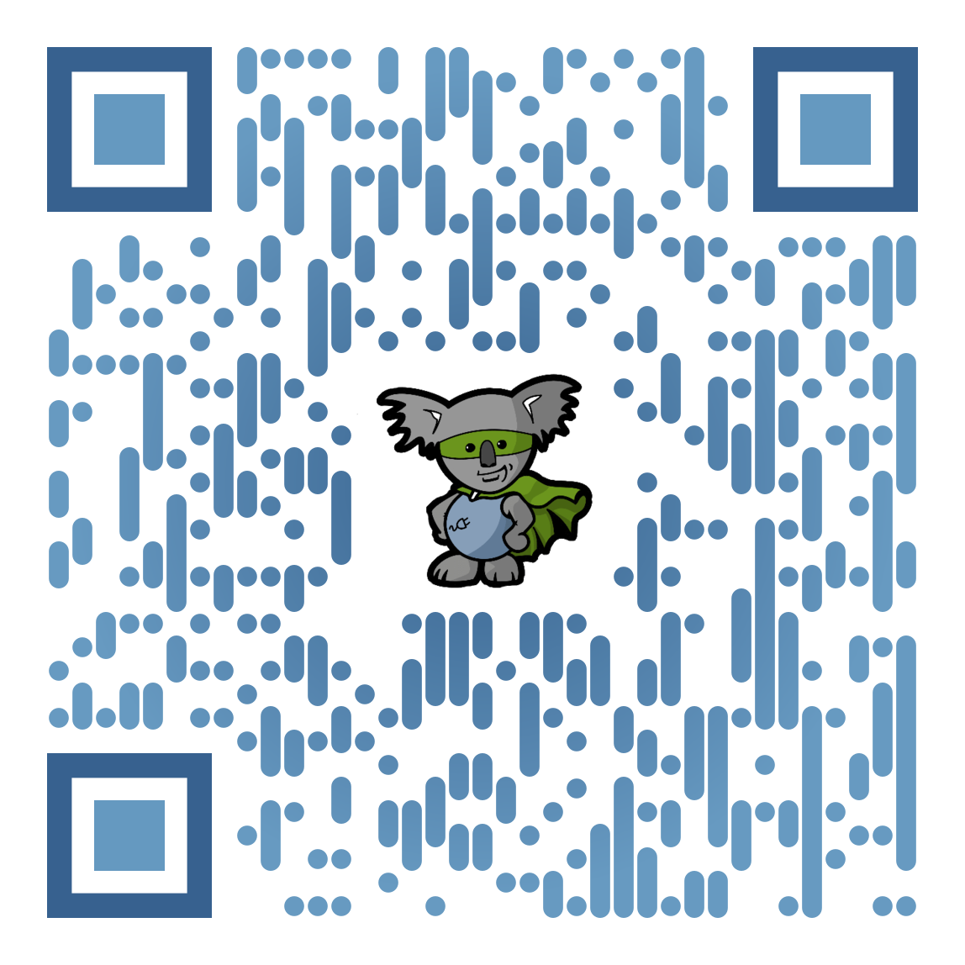
#iotsucks
http://bit.ly/iotsucks

Slide 29
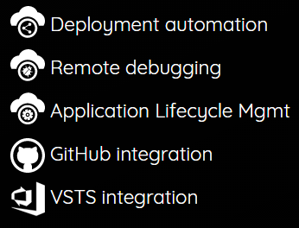


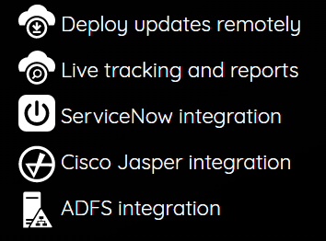

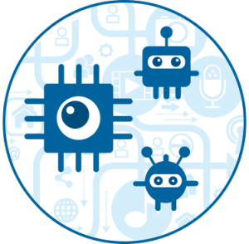
Axians – IoT Operation
Device Mgmt
Customer A
IOT HUB
Customer B
IOT HUB
Customer C
IOT HUB

Slide 30



Axians – IoT Operation
Device Mgmt
Customer A
IOT HUB
SERVICE DESK
Customer B
IOT HUB
NETWORK OPERATIONS CENTER
Customer C
IOT HUB

Slide 31
Axians – IoT Operation
Device Mgmt
Customer A
IOT HUB
Incidents
Issue tracking
Problem Management
Change Management
Release Management
Knowledge base
ITIL
SERVICE DESK
Customer B
IOT HUB
NETWORK OPERATIONS CENTER
Customer C
IOT HUB

Slide 32
IoT platforms
Certificates
SAS
Revoke
Sensor
Data
GATEWAY/ DEVICE
Transport
SECURITY
RULES & ROUTING
REPORTS
SQL / NOSQL
DEVICE MGMT
ERP / LOB
API
API
Node.js
ARM mbed
Java
.Net
Python
MQTT
AMQP
WebSockets
HTTP
Add/Remove
Enable/Disable
Metadata
State

Slide 33
Demo!
Working with Microsoft Azure Device SDK…

Slide 34

Managed devices
Edge gateway
Edge gateways are designed to be delegated workload that otherwise would have been processed in the cloud. Reasons such as large data volumes or requirements for low latency makes the Edge alternative a preferred solution.
Scenarios:
Processing of live video streams
Machine learning with concurrent predictions
Price range: €500-€2000
Field gateway
Field gateways are used mainly to steer and collect data from meters or sensors which are otherwise not able to connect to the cloud. Field gateways are also used to pre-process data before sent to the cloud.
Scenarios:
Manage PLC’s and industrial meters
Access point
Protocol conversion
Price range: €150-€5000
Microcontroller
Due to its low cost, microcontrollers can be installed in large volumes. And although they are much less powerful, they can provide valuable computation and processing of data. Microcontrollers can also be used as “slaves” to Edge- and Field gateways.
Scenarios:
BLE/ZigBee routers
Protocol conversion
Embedded systems
Price range: €50-€200

Slide 35

microServiceBus.com
Node options
Tier 1 (node.js)
Tier 1 Nodes are based on node.js and represents the full fletched option. This is the default choice and provides a fully managed gateway and supports all features available in micoroServiceBus.com
Tier 2 (Python)
Tier 2 Nodes are based on python and targets smaller gateways where we still control the software on the device but where the hardware is limited.
Tier 3
Tier 3 Nodes are sometimes referred to as 3rd party Nodes. These Nodes are managed through other services but can also be managed using microServiceBus.com through API’s provided by 3rd party.
Device Management
Device Management
Device Management
Start/Stop
Reset
Reboot
Ping
Device info
Disconnect policies
Manage logs
Audit logs
Login info
Device state & configuration
IoT Hub provider independent
Manage firmware
Start/Stop
Reset
Reboot
Ping
Remote debug
Remote terminal
Device info
Run scripts
Data visualizer
Transfer files
Resend messages
Disconnect policies
Manage logs
Audit logs
Login info
Vulnerability scan
Device state & configuration
IoT Hub provider independent
Remote access management
Manage Firmware
Start/Stop
Reset
Reboot
Ping
Update
Configuration
IoT Hub provider independent
Application Management
*) The level of service mentioned above might be more limited depending on what API’s are provided by 3rd party.
Manage & execute Scripts
Remote console
Tracking
Application Management
Manage & run Flows
Manage & execute Scripts
Manage Ubuntu Snaps
Manage Docker containers
Remote console
Tracking
Notes:
Who we are; Apart from being part of Vinci Energies
Axians IoT has a background in electro engineering, we have experience and knowledge protocols like modbus, mBus, for example
We have a System integration, A big part of IoT is integrations and having the experience with system integrations gives us the knowledge of how to build stable systems
Cloud, we have the knowledge of and
Operations…
When we develop new solutions/features, we always have long term in mind and therefore we always look at the operations side and how to manage the solutions we build.

Slide 36
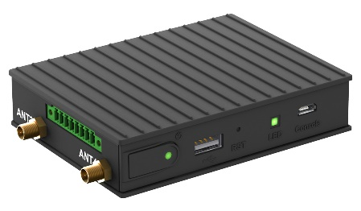
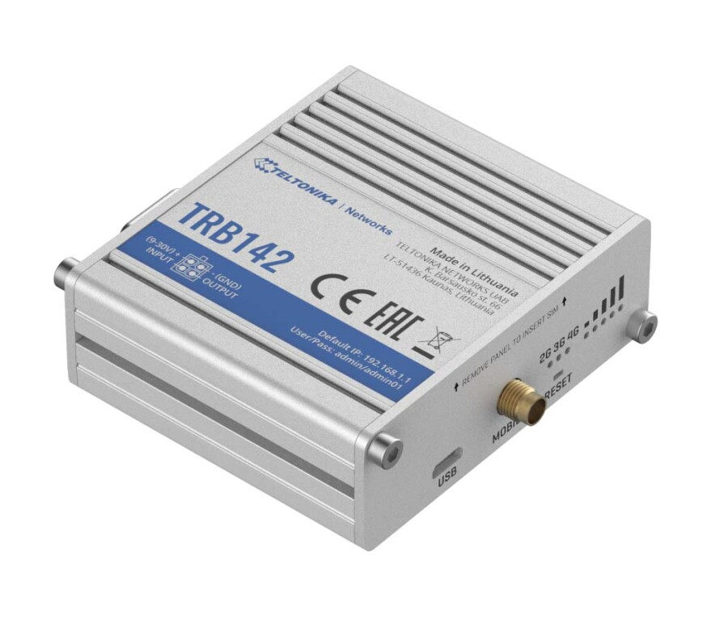
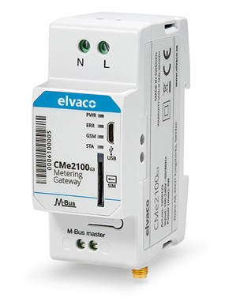
microServiceBus.com
Node options - Examples
Tier 1
Tier 1 Nodes are based on node.js and represents the full fletched option. This is the default choice and provides a fully managed gateway.
Tier 2
Tier 2 Nodes are based on python and targets smaller gateways where we still control the software on the device but where the hardware is limited.
Tier 3
Tier 3 Nodes are sometimes referred to as 3rd party Nodes. These Nodes are managed through other services but can also be managed using microServiceBus.com through API’s provided by 3rd party.
Compulab IOT-GATE-iMX7
CPU: ARM Cortex-A7, 1GHz
RAM: 2GB
Storage: 32GB eMMC
Price: from $120
Teletonika TRB142
CPU: ARM Cortex-A7 1.2GHz
RAM: 128MB
Storage: 512MB
Price: from $80
Elvaco 2100
CPU: Not relevant
RAM: Not relevant
Storage: Not relevant
Price: from $200
Notes:
Who we are; Apart from being part of Vinci Energies
Axians IoT has a background in electro engineering, we have experience and knowledge protocols like modbus, mBus, for example
We have a System integration, A big part of IoT is integrations and having the experience with system integrations gives us the knowledge of how to build stable systems
Cloud, we have the knowledge of and
Operations…
When we develop new solutions/features, we always have long term in mind and therefore we always look at the operations side and how to manage the solutions we build.

Slide 37
General Device Architecture
Field Gateway
Sensor API
COM SDK
Security
Plan for change
On-boarding strategy
Agent
<CODE>
Platform
mBed | Node.js | Python | Java | .Net
Operating system
Linux | Windows | RTOS

Slide 38
microServiceBus Architecture (node.js)
Field Gateway
Interacting with sensors & business logic
Frequently updates (weekly)
Service
Service
Service
Responsible for IoT Hub & orchestration of services
Often updates (once or twice a month)
Agent
microServiceBus-core
Responsible for initial communication with mSB.com
Rarely updates (once or twice a year)
Agent
microServiceBus-node
Platform
Node.js
Operating system
Linux

Slide 39

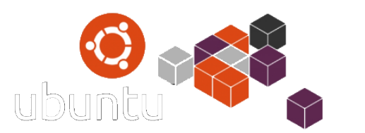
Ubuntu Core/Docker Device Architecture
Field Gateway
Interacting with sensors & business logic
Frequently updates (weekly)
Service
Service
Service
Responsible for IoT Hub & orchestration of services
Often updates (once or twice a month)
Agent
microServiceBus-core
Responsible for initial communication with mSB.com
Rarely updates (once or twice a year)
Agent
microServiceBus-node
Platform
Node.js
Operating system
Linux | Windows

Slide 40

Yocto Device Architecture
Gateway
Service
Service
Service
Service
Service
Service
Agent
Agent
microServiceBus-core
microServiceBus-core
Agent
Agent
microServiceBus-node
microServiceBus-node
Platform
Platform
Node.js
Node.js
Yocto Image
Operating system
Operating system
Linux (Yocto)
Linux (Yocto)

Slide 41
GitHub Repos:
axians/microservicebus.com (private)
axians/microservicebus.functions (private)
axians/microservicebus.node (public)
axians/microservicebus.core (public)
axians/microservicebus-py (public)
axians/microservicebus.mbed (public)
axians/microservicebus.gccbuild (public)
axians/microservicebus.snippets (public)
axians/microservicebus.rootservices (public)
axians/microservicebus.tutorial (public)
axians/microservicebus.docs (public)
axians/meta-microservicebus (public)
axians/meta-microservicebus-imx7 (public)
axians/ meta-microservicebus-imx8 (public)
axians/ meta-microservicebus-intel(public)
axians/meta-microservicebus-imx7-customer (private)
axians/ meta-microservicebus-imx8-customer (private)
axians/ meta-microservicebus-intel-customer (private)
You are more than welcome to help out!

Slide 42





microServiceBus.com and related projects are property of Vinci-Energies!

Slide 43
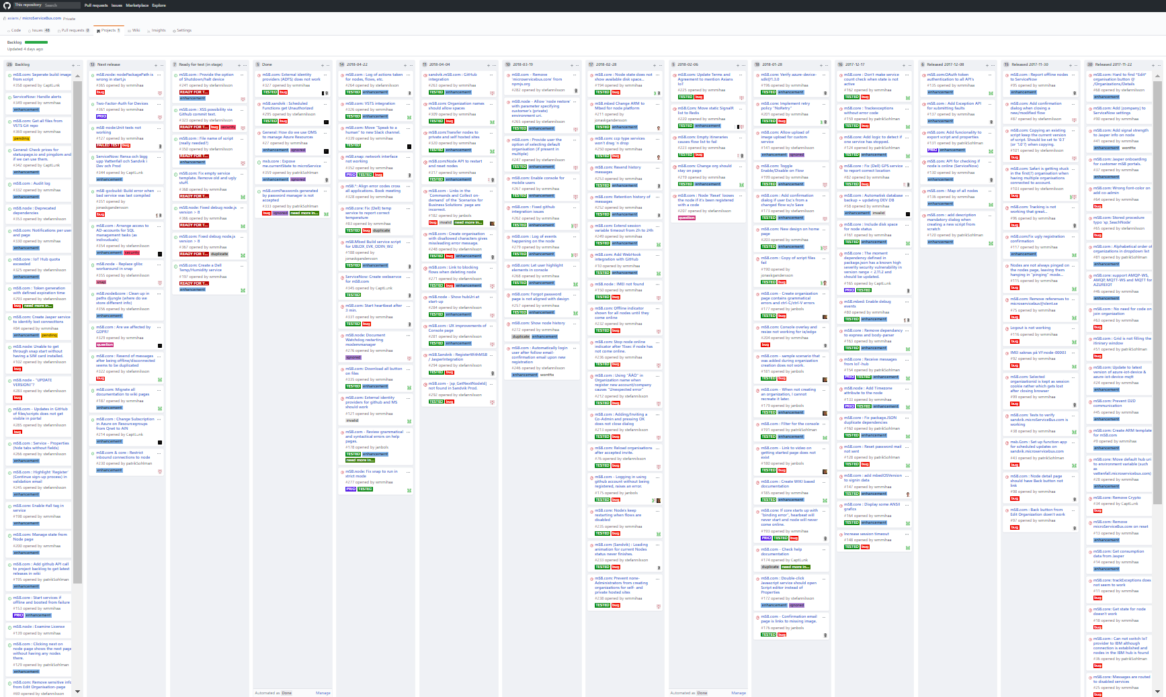
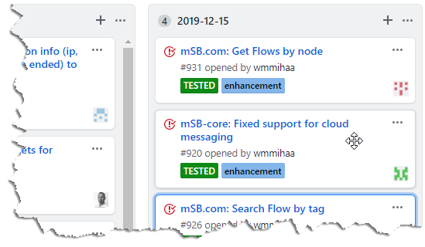
3000+ commits 2019!
3900+ commits 2021…
3000+ commits 2019!

Slide 44

microServiceBus.com DOCS https://docs.microservicebus.com/

Slide 45
Let’s begin https://github.com/axians/microservicebus-tutorial

Slide 46
(very) Short introduction to Node.js

Slide 47

What is Node.js?
Node.js® is a JavaScript runtime built on Chrome's V8 JavaScript engine.
Node.js uses a single threaded, event-driven, non-blocking I/O model that makes it lightweight and efficient.
Node.js is platform independent.

Slide 48
What is Node.js?
APPLICATION
NODE.JS
BINDINGS
(NODE API)
LIBUV
(ASYNCHRONOUS I/O)
JAVASCRIPT
EVENT QUEUE
WORKER THREADS
BLOCKING OPERATION
V8
(JAVASCRIPT ENGINE)
FILE
NETWORK
OS OPERATIONS
EVENT LOOP
PROCESS
EXECUTE CALLBACK

Slide 49
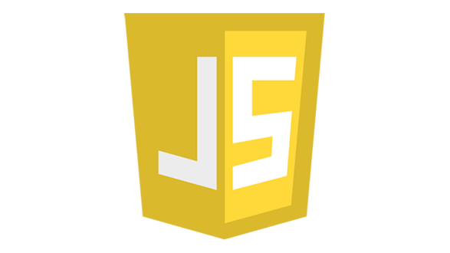
What is JavaScript?
compiled
A high-level, dynamic, untyped, and interpreted programming language. It has been standardized in the ECMAScript language specification
Notes:
High-level … förlåtande
Förklara att javascript är ett JIT kompilerat språk
var a = 2;
console.log(a);
3();

Slide 50

Node Package Manager (NPM)
npm is the default package manager for the JavaScript runtime environment Node.js and allows users to consume and distribute JavaScript modules that are available on the registry.
Npm has over 500K+ packages today, which is almost as much as Java, .Net and Python combined!

Slide 51
Demo!
+
Notes:
Understryk att detta inte är en JS kurs. All kod kan kopieras
console.log via terminal
console.log via app.js
npm i colosrs
console.log via app.js w/ colors

Slide 52
JavaScript 101
Types and values
Variable scopes
Functions

Slide 53
JavaScript 101 – Values and Types
Primitive values
Boolean
Number
String
Null
Undefined
Objects
Date
Structured data (aka JavaScript Object)
Collections
Functions
Classes
Notes:
var a = 12.12345;
var b = a.toFixed(2) / 1;

Slide 54

JavaScript – Values and Types
Explicit Conversions
String()
Number()
Implicit Conversion
var a = 12;
a = a + ' hours';
Notes:
var a = 12.12345;
var b = a.toFixed(2) / 1;

Slide 55
JavaScript - Operators
EQUAL
a = 1;
a = a + 2;
a += 2;
EQUALITY
a == b (loose-equals)
a === b (strict-equals)
a != b (loose-not-equals)
a !== b (strict-not-equals)
”falsy” values:
0
-0
””
false
null
undefined
if(error){
// handle error
}

Slide 56
JavaScript - Variable scopes
var a = 42; //(Function scope)
let b = 16; //(Block scope)
const c = 7; //(Block scope)

Slide 57
JavaScript - Functions
function foo(){
return "bar";
}
var foo = function(){
return "bar";
}
var foo = () => {
return "bar";
}

Slide 58
JavaScript - Functions
… and callbacks…

Slide 59
JavaScript - Functions
this

Slide 60
+
+
Notes:
Understryk att detta inte är en JS kurs. All kod kan kopieras
console.log via terminal
console.log via app.js
npm i colosrs
console.log via app.js w/ colors

Slide 61
What is an IoT Hub?
IoT Hub
Device state – Configuration
Messaging – Cloud > Device
Events – Device > Cloud
Repository

Slide 62
Demo!
+
+
Notes:
Understryk att detta inte är en JS kurs. All kod kan kopieras
console.log via terminal
console.log via app.js
npm i colosrs
console.log via app.js w/ colors

Slide 63
microServiceBus.com - Key concepts
Organization
“Subscription” owning flows, services & nodes
Services
Nodes
Cloud connected agent, hosting one or more flows
Code interacting with HW or other services
Inbound service
Outbound service
Other service
Flows
Process execution of services

Slide 64
Demo!
microServiceBus.com - Key concepts

Slide 65






microServiceBus Architecture
IoT Hub
microServiceBus.com
Issue tracking
Sim card mgmt
Field Gateway

Slide 66
ServiceNow integration
microServiceBus.com
Issue tracking
{Create CI}
{offline node}
{Create Incident}
{tracking}
Field Gateway

Slide 67
microServiceBus Architecture
IoT Hub
microServiceBus.com
Sim card mgmt
Field Gateway

Slide 68




On-boarding
4. Register device
3. Notification
IOT HUB
SIM CARD MANAGEMENT
IoT Hub
microServiceBus.com
DEVICE MANAGEMENT
5. Credentials
6. Config
2. Request config
?
7. Send & Receive
1. Activate SIM card
IOT DEVICE

Slide 69

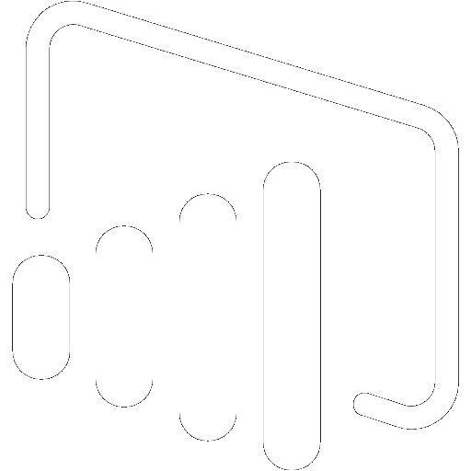

Getting Started
Sensor
Gateway
Azure
IoT Hub
Azure
Stream Analytics
Microsoft
Power BI
microServiceBus.com

Slide 70
Lab time!
http://bit.ly/msbtutorial
Tools & Services
Chrome
Node.js
Visual Studio Code
Postman
GitHub
microServiceBus

Slide 71
Lab time!
http://bit.ly/msbtutorial
Getting started: Build your first solution
Device Management: Manage your devices and IoT Hub
Working with Policies: Manage how your Nodes handle disconnected state
Working with Templates: Simplify configuration of nodes
Insight and audit logs: Manage your devices and IoT Hub
Application Lifecycle Management: Manage your devices and IoT Hub
microServiceBus.com API: Integrate with microServiceBus.com API

